Slide 1
What should I drink?
Mark Orland

Slide 2
The Problem
Fear
Time
Confidence
Money
Notes:
Fear
people are afraid to try new things and broaden their horizons
Time
people take forever to look through a drink menu
Confidence
just ask the waiter/waitress → trusting one person who you just meet to gauge your tastes
Money
restaurant industry, instead of a customer spending 5 minutes looking at a menu they can get a recommendation on the fly

Slide 3
The Data - Beer
Beer Advocate
Top 250 beers
2500 review per beer
625,000 reviews
62,487 useable reviews
Notes:
Useable review = actually had a text review

Slide 4
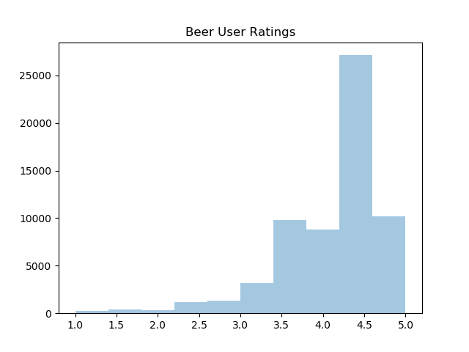
Notes:
1-5 scale
Mean 4.1
42,932 were 4 star reviews or higher

Slide 5
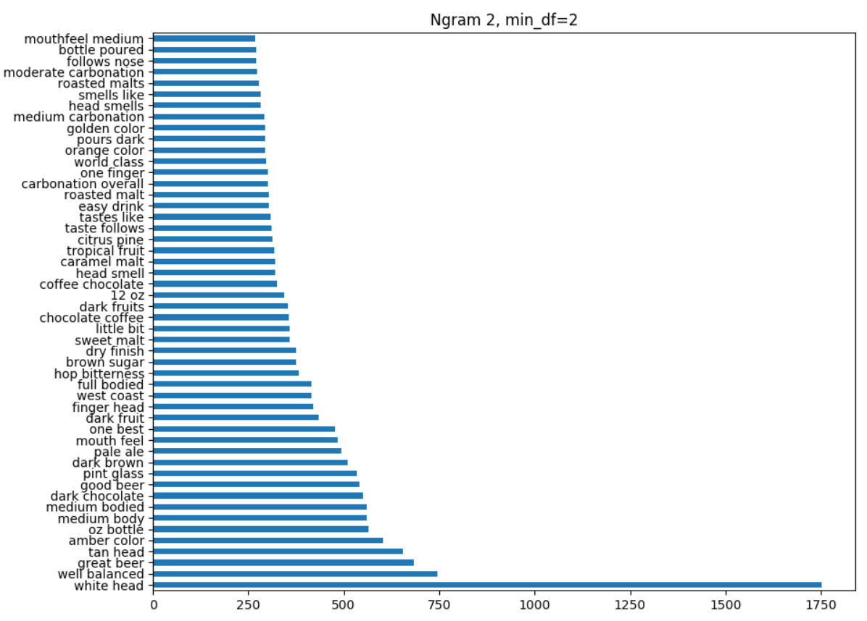
Notes:
White head
Amber color
Dark chocolate
Hop bitterness
Sweet malt
Chocolate coffee
Citrus pine

Slide 6
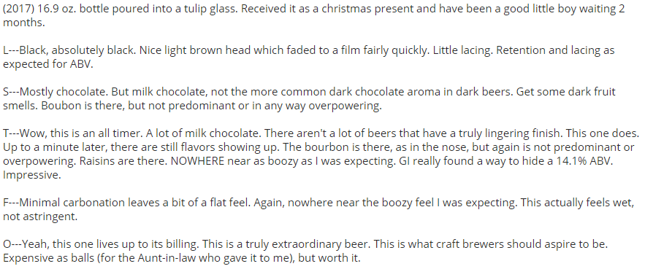

Slide 7
The Data - Whiskey
LA Whiskey Society
3.5 years
Less than $1000
Greater than an F
Notes:
422 whiskey

Slide 8
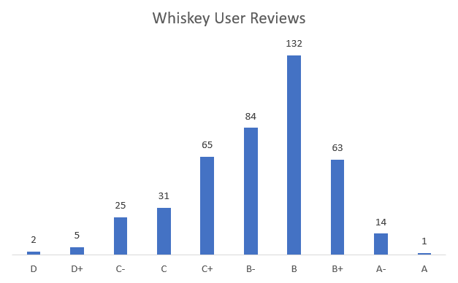
Notes:
Mean B-
A = Virtually ideal, a superstar whiskey
B = Good, might want to own
C = Fine to drink (if there is nothing else)
D = Unpleasant. Not recommended.
F = Horrific swill to be avoided at all costs
{'a': 5, 'aminus': 4.5, 'bplus': 4.25, 'b': 4, 'bminus': 3.5, 'cplus': 3.25, 'c': 3, 'cminus': 2.5, 'dplus': 2.25, 'd': 2, 'dminus': 1.5}

Slide 9
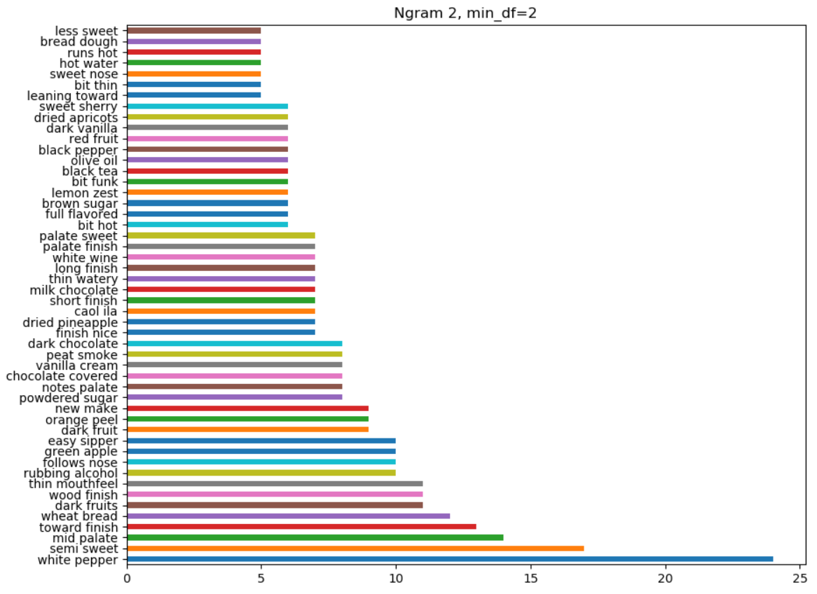
Notes:
White pepper
Wheat bread
Wood finish
Rubbing alcohol
Powdered sugar

Slide 10

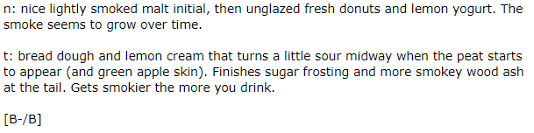
Notes:
P – palate
N – nose
F – finish

Slide 11
The Recommender
Review Comparison
www.whatshouldidrink.xyz
Notes:
Generates a profile for each alcohol based on the reviews then compares the profiles to find what is most similar

Slide 12
Thank you

